Slide 1
Introduction to Artificial Intelligence– CII2M3
Nearest Neighbor
ADF – Start 08:30

Slide 2
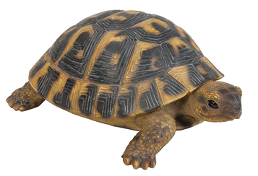
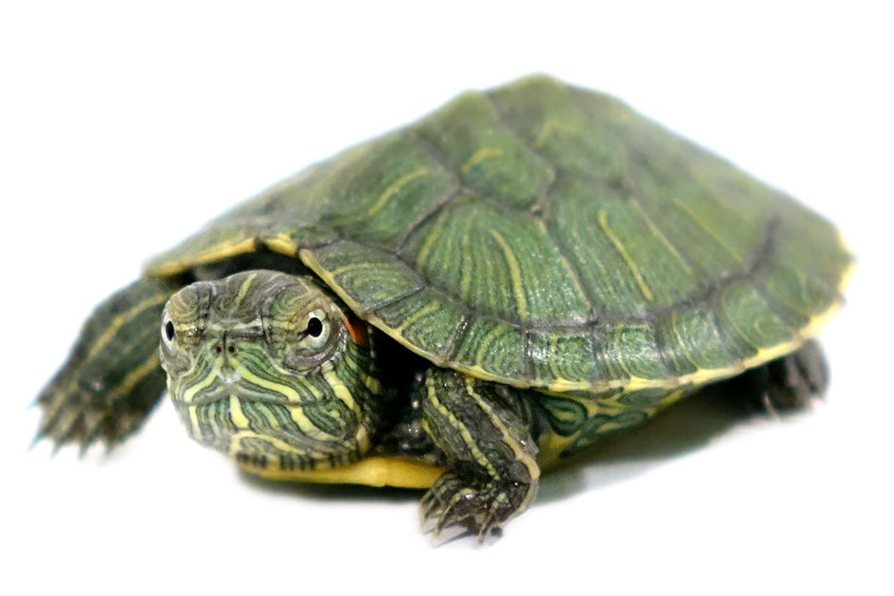
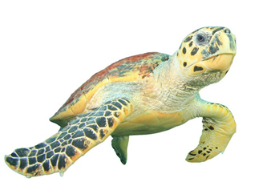
Nearest Neighbor
Introduction to Artificial Intelligence

Slide 3
Enormous Attributes
Decision tree is good for limited and discrete attributes
In case of classification with numerous attributes,
the tree resulted might be too complex and prone to overfit
For example: in image classification
Introduction to Artificial Intelligence

Slide 4
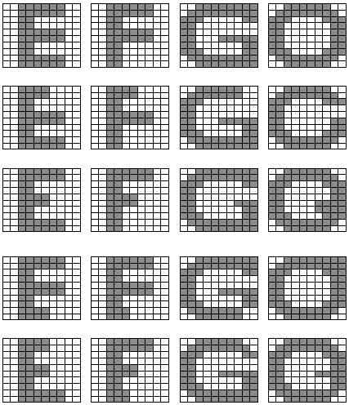
Character Recognition
20 data
10x10 pixel
4 class
Introduction to Artificial Intelligence

Slide 5
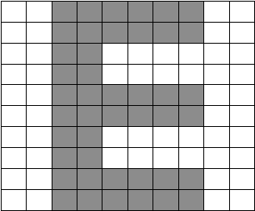
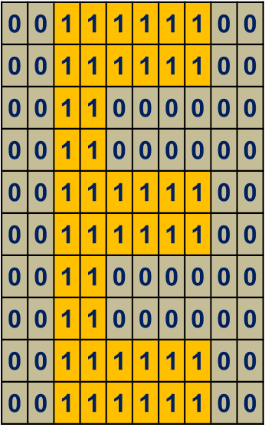
Character Recognition
To ease the computation, change data into 1D array
Introduction to Artificial Intelligence

Slide 6
Character Recognition Dataset
 | Pix 1 | Pix 2 | Pix 3 | Pix 4 | Pix 5 | … | Pix 100
E1 | 0 | 0 | 1 | 1 | 1 | … | 0
F1 | 0 | 0 | 1 | 1 | 1 | … | 0
G1 | 0 | 0 | 1 | 1 | 1 | … | 0
O1 | 0 | 0 | 1 | 1 | 1 | … | 0
..
O5 | 0 | 0 | 1 | 1 | 1 | … | 0
20 data
100 dimensional
4 class
Introduction to Artificial Intelligence

Slide 7
Character Recognition – ID3
Let’s say we try to build character classifier based on pixel input using ID3
What will happen?
Introduction to Artificial Intelligence

Slide 8
Character Recognition – ID3
Introduction to Artificial Intelligence

Slide 9
Character Recognition – ID3
The tree will be too long
A complete ID3 will result a 100-level-depth tree (100-dimensional input)
Not efficient
px48
1
0
E
px20
1
0
px85
px12
Introduction to Artificial Intelligence

Slide 10
Nearest Neighbor
Introduction to Artificial Intelligence

Slide 11
Nearest Neighbor
Simple algorithm that stores all available cases and classifies new cases based on a similarity measure
Non-parametric techniques
Other names:
Memory-Based Reasoning
Example-Based Reasoning
Instance-Based Learning
Case-Based Reasoning
Lazy Learning
Introduction to Artificial Intelligence

Slide 12
Nearest Neighbor
Training Process
Memorize all training data and labels
Testing Process
Use L1 or L2 (or other distance choices) distance to each and every training data, return label of the closest one
L1 : Manhattan Distance
L2 : Euclidean Distance
Introduction to Artificial Intelligence

Slide 13
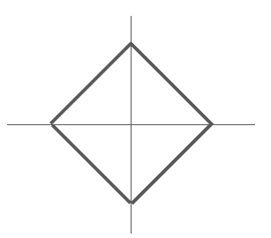
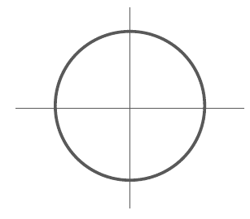
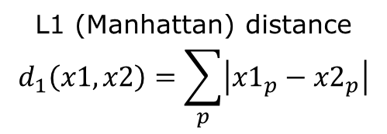
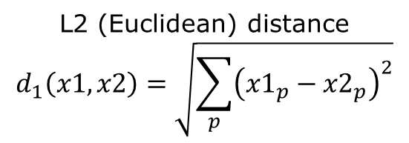
Distance Metric
L1 (Manhattan) distance
$$d_{1}\left(x1,x2\right)=\sum_{p}{\left|{x1}_{p}−{x2}_{p}\right|}$$
L2 (Euclidean) distance
$$d_{1}\left(x1,x2\right)=\sqrt{\sum_{p}{{\left({x1}_{p}−{x2}_{p}\right)}^{2}}}$$
Introduction to Artificial Intelligence

Slide 14
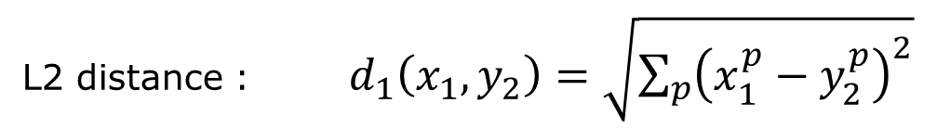




Nearest Neighbor
L2 distance : $d_{1}\left(x_{1},y_{2}\right)=\sqrt{\sum_{p}{{\left(x_{1}^{p}−y_{2}^{p}\right)}^{2}}}$
test data ($x$)
train data ($y$)
$$2$$
value differences
1 | 1 | 1 | 1
1 | 0 | 0 | 0
1 | 1 | 1 | 0
1 | 0 | 0 | 0
1 | 1 | 1 | 0
1 | 0 | 0 | 1
1 | 0 | 0 | 1
1 | 1 | 1 | 0
0 | 0 | 0 | 1
0 | 0 | 0 | 1
0 | 1 | 1 | 1
0 | 1 | 1 | 0
sqrt(add)
-
=
$$\sqrt{7}$$
Introduction to Artificial Intelligence

Slide 15
Nearest Neighbor
L1 distance : $d_{1}\left(x_{1},y_{2}\right)=\sum_{p}{\left|x_{1}^{p}−y_{2}^{p}\right|}$
test data ($x$)
train data ($y$)
value differences
1 | 1 | 1 | 1
1 | 0 | 0 | 0
1 | 1 | 1 | 0
1 | 0 | 0 | 0
1 | 1 | 1 | 0
1 | 0 | 0 | 1
1 | 0 | 0 | 1
1 | 1 | 1 | 0
0 | 0 | 0 | 1
0 | 0 | 0 | 1
0 | 1 | 1 | 1
0 | 1 | 1 | 0
add
-
=
7
Introduction to Artificial Intelligence

Slide 16
Nearest Neighbor
L1 distance : $d_{1}\left(x_{1},y_{2}\right)=\sum_{p}{\left|x_{1}^{p}−y_{2}^{p}\right|}$
test data ($x$)
train data ($y$)
value differences
1 | 1 | 1 | 1
1 | 0 | 0 | 0
1 | 1 | 1 | 0
1 | 0 | 0 | 0
1 | 1 | 1 | 0
1 | 0 | 0 | 1
1 | 1 | 1 | 1
1 | 0 | 0 | 0
0 | 0 | 0 | 1
0 | 0 | 0 | 1
0 | 0 | 0 | 1
0 | 0 | 0 | 0
add
-
=
3
Introduction to Artificial Intelligence

Slide 17
Nearest Neighbor Algorithm
For each test data A,
loop through all training data, calculate the distance
Choose the closest training data point X
Set the label of X as label of data test A
Nearest neighbor intuition
Since A is similar to X (the attributes are close), then A and X must be the same class
Introduction to Artificial Intelligence

Slide 18
Character Recognition with Nearest Neighbor Training and Testing
Introduction to Artificial Intelligence

Slide 19
Nearest Neighbor Learning Process
Let’s say we use 16 data as training data
Reshape into vectors
Introduction to Artificial Intelligence

Slide 20
Nearest Neighbor Learning Process
Save to database,
And that’s it for Learning Process
Introduction to Artificial Intelligence

Slide 21
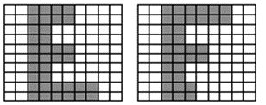
Nearest Neighbor Testing Process
Now we want to classify new data using Nearest Neighbor
First, we change new data into 1 dimensional
Then calculate distance to the 16 data training
Introduction to Artificial Intelligence

Slide 22
Nearest Neighbor Testing Process
E | 2.8
E | 2
E | 2
E | 3.5
F | 4
F | 3.5
F | 3.5
F | 3.7
G | 6.7
G | 6.4
G | 7.1
G | 6.9
O | 6.9
O | 6.6
O | 7.2
O | 7.1
E | 2
E | 2
E | 2.8
E | 3.5
F | 3.5
F | 3.5
F | 3.7
F | 4
G | 6.4
O | 6.6
G | 6.7
G | 6.9
O | 6.9
G | 7.1
O | 7.1
O | 7.2
Return label of the closest data
sort
E
Loop calculate the distance between test data and all training data resulting array of distance
Introduction to Artificial Intelligence

Slide 23
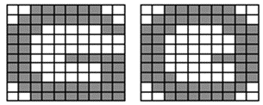
Nearest Neighbor Testing Process
E | E | E | E | F | F | F | F | G | G | G | G | O | O | O | O
2.8 | 2 | 2 | 3.5 | 4 | 3.5 | 3.5 | 3.7 | 6.7 | 6.4 | 7.1 | 6.9 | 6.9 | 6.6 | 7.2 | 7.1
3.2 | 3.7 | 2.4 | 2.4 | 2.4 | 3.2 | 1.4 | 2 | 6.9 | 6.6 | 7.3 | 7 | 7.1 | 6.8 | 7.3 | 7.3
6.6 | 6.9 | 6.6 | 6.9 | 7.2 | 7.5 | 7.2 | 7.1 | 1.7 | 2.6 | 1.7 | 2.6 | 3.2 | 2.4 | 3.2 | 3.6
6.8 | 7.1 | 6.8 | 7.1 | 7.3 | 7.6 | 7.3 | 7.2 | 2.2 | 3 | 3.3 | 3 | 1.4 | 2.4 | 1.4 | 2.2
Introduction to Artificial Intelligence

Slide 24
Nearest Neighbor Problem
Introduction to Artificial Intelligence

Slide 25
Nearest Neighbor
Training Speed?
O(1)
No training, just save all training data
Testing Speed?
O(N)
Linearly slower according to the size of training data
Introduction to Artificial Intelligence

Slide 26
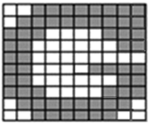

Character Recognition using Nearest Neighbor
G? O?
E? F?
E | E | E | E | F | F | F | F | G | G | G | G | O | O | O | O
6.9 | 7.1 | 6.9 | 7.1 | 7.4 | 7.7 | 7.4 | 7.3 | 2.4 | 3.2 | 2.4 | 2 | 2.6 | 2.6 | 2.6 | 2
3.2 | 3.2 | 2.4 | 2.4 | 3.2 | 3.2 | 2.4 | 2.8 | 6.9 | 6.6 | 7.3 | 7 | 7.1 | 6.8 | 7.3 | 7.3
Introduction to Artificial Intelligence

Slide 27
k-Nearest Neighbor
Introduction to Artificial Intelligence

Slide 28
K-Nearest Neighbor
Use many neighbors to determine the class
Choose k-closest data point
Majority vote the label
K-NN can be use for Classification and Regression
For classification select the most frequent neighbor.
For regression calculate the average of K neighbors
Introduction to Artificial Intelligence

Slide 29
Character Recognition using k-NN
K = 3
E | E | E | E | F | F | F | F | G | G | G | G | O | O | O | O
6.9 | 7.1 | 6.9 | 7.1 | 7.4 | 7.7 | 7.4 | 7.3 | 2.4 | 3.2 | 2.4 | 2 | 2.6 | 2.6 | 2.6 | 2
sort
G | O | G | G | O | O | O | G | E | E | E | E | F | F | F | F
2 | 2 | 2.4 | 2.4 | 2.6 | 2.6 | 2.6 | 3.2 | 6.9 | 6.9 | 7.1 | 7.1 | 7.3 | 7.4 | 7.4 | 7.7
2G, 1O = G
Introduction to Artificial Intelligence

Slide 30
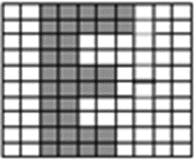
Character Recognition using k-NN
K = 3
E | E | E | E | F | F | F | F | G | G | G | G | O | O | O | O
3.2 | 3.2 | 2.4 | 2.4 | 3.2 | 3.2 | 2.4 | 2.8 | 6.9 | 6.6 | 7.3 | 7 | 7.1 | 6.8 | 7.3 | 7.3
sort
E | E | F | F | E | E | F | F | G | O | G | G | O | G | O | O
2.4 | 2.4 | 2.4 | 2.8 | 3.2 | 3.2 | 3.2 | 3.2 | 6.6 | 6.8 | 6.9 | 7 | 7.1 | 7.3 | 7.3 | 7.3
2E, 1F = E
Introduction to Artificial Intelligence

Slide 31
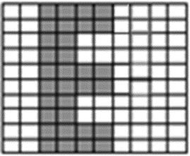
Character Recognition using k-NN
K = 3
E | E | E | E | F | F | F | F | G | G | G | G | O | O | O | O
3.5 | 2.8 | 2.8 | 2.8 | 3.5 | 2.8 | 2.8 | 3.2 | 7 | 6.7 | 7.4 | 7.1 | 7.2 | 6.9 | 7.5 | 7.4
E ?? F ??
Introduction to Artificial Intelligence

Slide 32
Character Recognition using k-NN
K = 3
E ?? F ??
sort
E | F | E | E | F | F | E | F | G | O | G | G | O | G | O | O
2.8 | 2.8 | 2.8 | 2.8 | 2.8 | 3.2 | 3.5 | 3.5 | 6.7 | 6.9 | 7 | 7.1 | 7.2 | 7.4 | 7.4 | 7.5
what will happened if the sorting result is
E | F | F | E | E | F | E | F | G | O | G | G | O | G | O | O
2.8 | 2.8 | 2.8 | 2.8 | 2.8 | 3.2 | 3.5 | 3.5 | 6.7 | 6.9 | 7 | 7.1 | 7.2 | 7.4 | 7.4 | 7.5
Introduction to Artificial Intelligence

Slide 33
Character Recognition using k-NN
K = 3
Change ➔ K = 5
sort
E | F | E | E | F | F | E | F | G | O | G | G | O | G | O | O
2.8 | 2.8 | 2.8 | 2.8 | 2.8 | 3.2 | 3.5 | 3.5 | 6.7 | 6.9 | 7 | 7.1 | 7.2 | 7.4 | 7.4 | 7.5
3E, 2F = E
Introduction to Artificial Intelligence

Slide 34
Character Recognition using k-NN
K = 3?
K = 5?
K = 7?
K = 10?
Which one is better?
Introduction to Artificial Intelligence

Slide 35
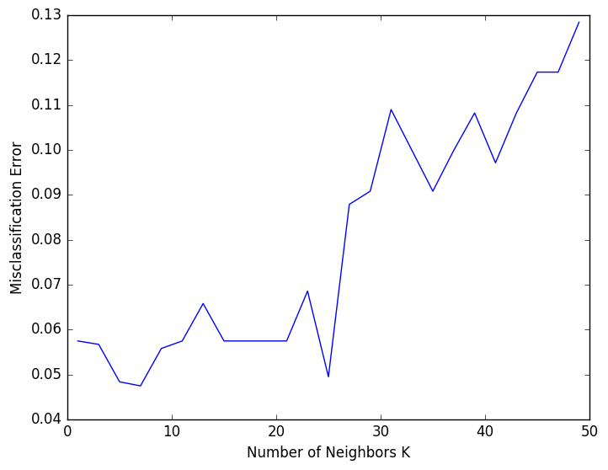
Character Recognition using k-NN
Observe and determine $k$ using validation set
Introduction to Artificial Intelligence

Slide 36
k-Nearest Neighbors - Hyperparameters
What is the best distance to use?
What is the best value of k to use?
Choices about the algorithm that we set rather than learn
Very problem-dependent.
Must try them all out and see what works best.
Use train set and validation set to avoid overfitting
Introduction to Artificial Intelligence

Slide 37
K-Fold Cross Validation
Start 09:30
Introduction to Artificial Intelligence

Slide 38
Hyperparameter Observation on Trainset?
We want to observe k={1, 2, 3, 4, 5}
What would happen if we check the performance on train set?
Best performance will ALWAYS be k=1
Introduction to Artificial Intelligence

Slide 39
Example K-Fold Cross Validation
Example K-Fold Cross Validation using 5 folds
Iteration 1
1,2,3,4 train
Fold 5 validation
Iteration 2
1,2,3,5 train
Fold 4 validation
Iteration 3
1,2,4,5 train
Fold 3 validation
…
fold 1 | fold 2 | fold 3 | fold 4 | fold 5
fold 1 | fold 2 | fold 3 | fold 4 | fold 5
fold 1 | fold 2 | fold 3 | fold 4 | fold 5
Introduction to Artificial Intelligence

Slide 40
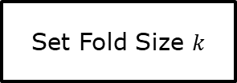
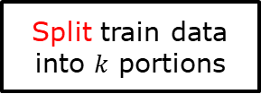
K-Fold Val: Hyperparameter Observation
Set Fold Size $k$
Split train data into $k$ portions
Set i-th portion as validation data
Select Hyperparameter
Train Model on Train Data using current Hyperparameter
Evaluate Model on Validation Data
yes
yes
Record Validation Performance
no
no
Repeat?
Next Hyperparameter?
Average Validation Performance over all iteration
Train Final Model on All train+val data using Best Hyperparameter
Test Model on Test Data
Get Best Hyperparameter
Introduction to Artificial Intelligence

Slide 41
K-Fold Val: Hyperparameter Observation
For each iteration
Try all hyperparameters
Record the validation acc
At the end of iteration, average the validation acc
Choose best hyperparameter
Use the chosen hyperparameter to test new data using ALL data (train+val)
Introduction to Artificial Intelligence

Slide 42
Note on kNN Hyperparameter Observation
Myth: k value should be an odd-number
Introduction to Artificial Intelligence

Slide 43
Question?
Introduction to Artificial Intelligence

